Slide 1

Mobile App Market Diagnostics
Data-Driven Insights across 10,800+ Android Applications to Guide App Strategy, UX Design, and Monetization

Slide 2

Executive Diagnostics
Empirical investigation into category saturation, install triggers, app size constraints, and revenue drivers to maximize app portfolio ROI.

Slide 3

Google Play Store Ecosystem Snapshot
92.6%
Freemium as the Default Engine
Out of 10,841 benchmarked applications, 92.6% are distributed free of charge, generating over 98% of total global download volume.
Upfront paid apps face severe friction; sustainable mobile revenue overwhelmingly depends on In-App Purchases (IAP), subscriptions, and targeted ad monetization.
Free App Share

Slide 4
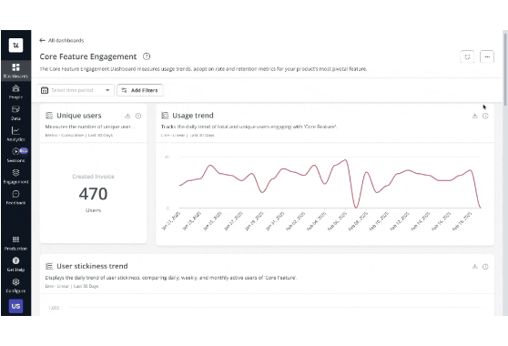
Dataset & Analytics Scope
10,841 App Profiles: Multi-variate records across 33 primary categories including Games, Family, Tools, and Finance.
Install & Scale Metrics: Quantified download tiers ranging from 1+ to 1 Billion+ installations.
UX & Feedback Indicators: Evaluated user sentiment, rating distributions (4.19 store average), review volume, and app size in MB.

Slide 5

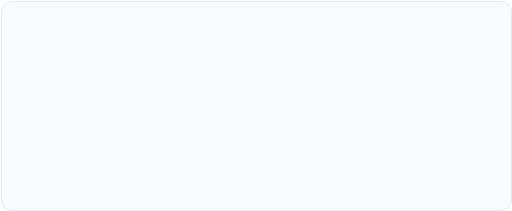
Category Landscape & Opportunity
1. Saturated Volume Leaders
2. High-Demand Blue Oceans
Family & Game categories account for over 30% of total app store listings (~3,800 apps). High saturation means organic discovery is difficult without massive User Acquisition (UA) ad spend.
Finance, Productivity, and Health & Fitness exhibit exceptional install-per-app ratios. Users demonstrate stronger intent and higher lifetime value (LTV) in these utility sectors.

Slide 6
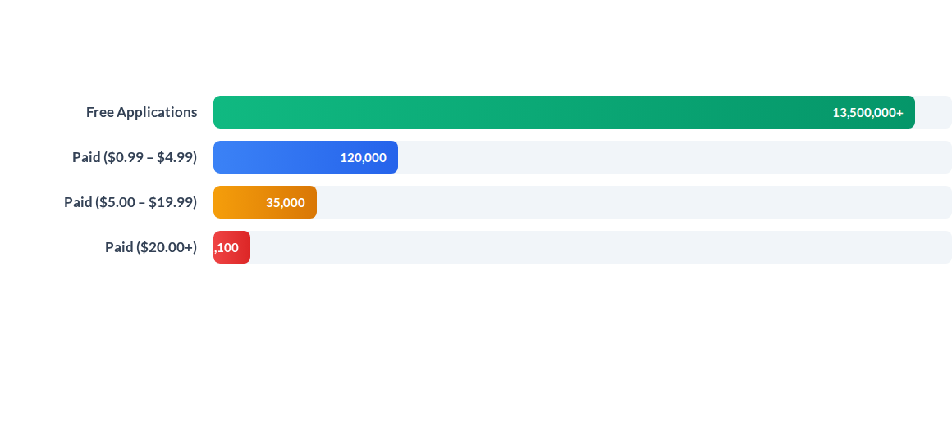
Average Downloads Across Price Tiers
Free apps drive over 100x more install volume than low-cost paid apps. Mobile strategy should focus on friction-free installation followed by tiered freemium upsells.

Slide 7
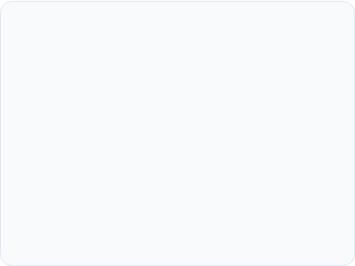
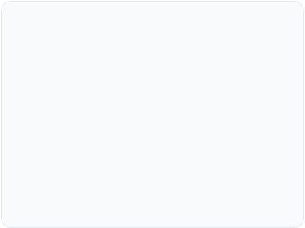
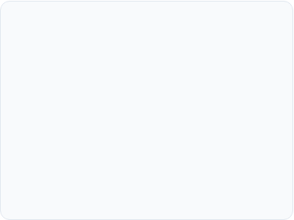



Core App Success Drivers
Rating Benchmark (4.2+)
Size Sensitivity (< 50MB)
Frequent Update Cycles
Apps rated above 4.2 capture 85%+ of total store downloads. Falling below 4.0 cuts conversion rate by over 50% on search impressions.
App sizes under 50MB achieve 2.4x higher conversion in tier-2/3 global markets where device storage and data caps remain strict.
Apps updated at least monthly show 38% higher 90-day retention, benefiting from active algorithmic boosting in search rankings.

Slide 8
Category Performance Matrix
Category Sector | Avg App Size | Avg Rating | Monetization Model | Strategic Potential
Game | 64.3 MB | 4.28 / 5.0 | In-App Purchases (IAP) + Ads
Finance | 28.1 MB | 4.13 / 5.0 | Freemium Subscriptions
Health & Fitness | 31.5 MB | 4.25 / 5.0 | Monthly Tiered Plans
Tools & Utilities | 18.2 MB | 4.04 / 5.0 | In-App Ad Network
Family & Casual | 42.7 MB | 4.19 / 5.0 | Hybrid Ad & Micro-IAP

Slide 9
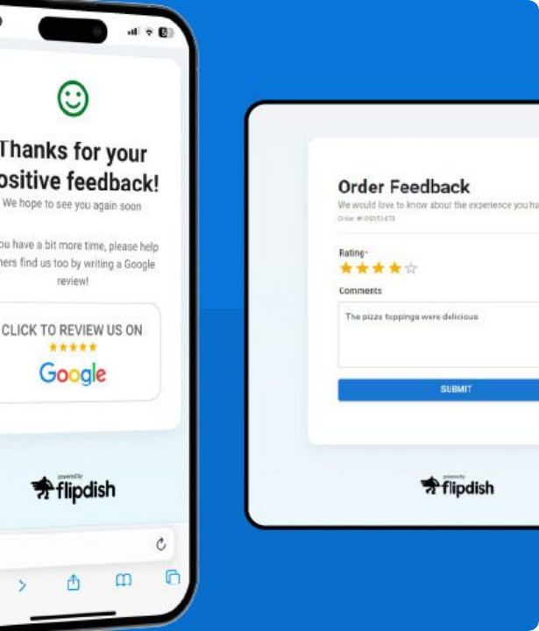
User Review Dynamics
Social Proof Engine
Review velocity directly dictates algorithm ranking on Google Play search. Unlocking 10,000+ positive reviews creates a self-sustaining viral organic acquisition loop.
Deploying smart in-app review prompts during moments of user satisfaction (e.g., milestone achievements) increases positive rating prompts by 3x.

Slide 10
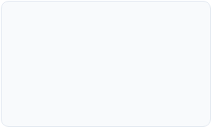


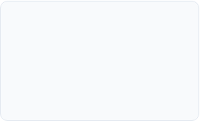
Product Growth Roadmap
Q2 - ASO & Review Prompts
Q4 - Bi-Weekly CI/CD
Implement smart in-app review triggers to cross the 4.2+ rating threshold.
Establish automated release pipeline to push bi-weekly updates and bug fixes.
Q1 - Lightweight MVP
Q3 - Hybrid Monetization
Build optimized APK under 30MB targeting high-intent Health/Finance niches.
Launch freemium subscription paywall alongside non-intrusive native ads.

Slide 11
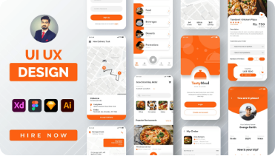

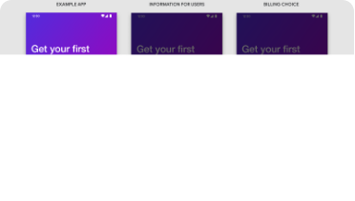
Strategic Action Pillars
UX & Size Optimization
ASO & Rating Velocity
Freemium Monetization
Keep binary size lean (<30MB) and focus on rapid onboarding to minimize initial drop-off.
Optimize app store metadata and trigger early positive reviews to boost store search visibility.
Maximize user funnel reach with free installs while driving high LTV via premium subscriptions.

